Slide 1
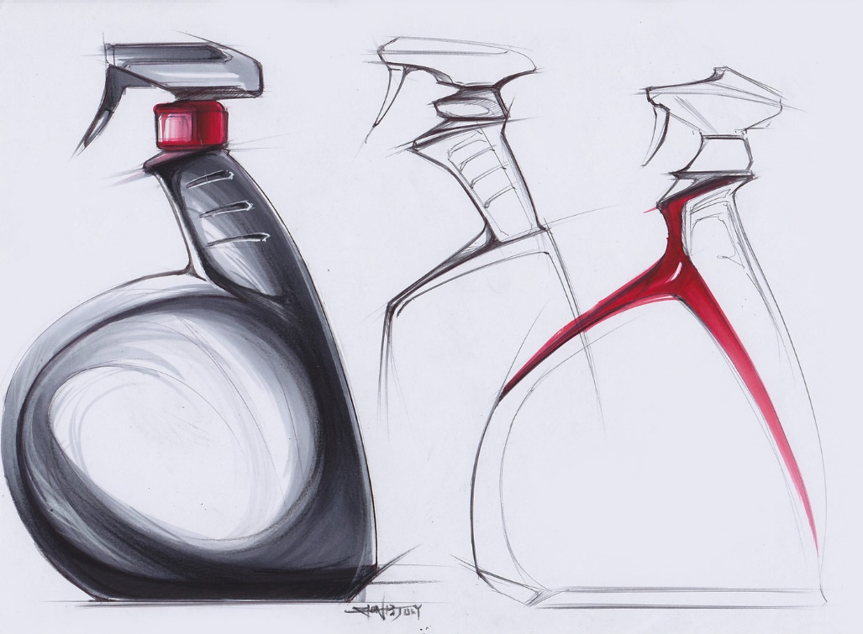
nat5 Design & Manufacture
Design Development

Slide 2
Learning intentions & success criteria
Learning Intentions
Gain an understanding of the design development stage.
Success Criteria
Apply my knowledge of design development to my own work.
Demonstrate my skills in design development to add more detail to my initial ideas.
Demonstrate, through sketching and annotation, my own design development.

Slide 3
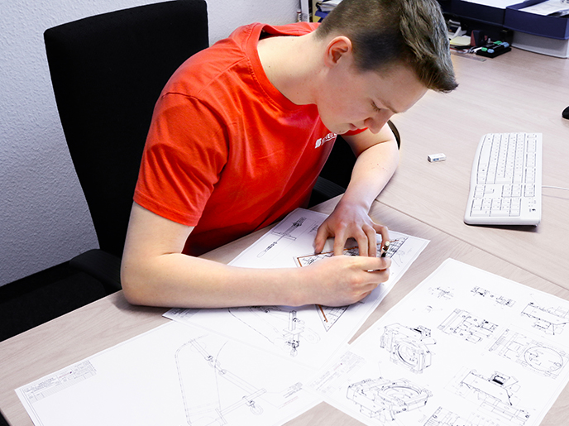
Design development
You must now develop your chosen initial idea.
You must identify and consider:
Areas for improvement
The design specification
This must include:
A greater level of detail
A clear evolution in the design
You can do this by:
Exploring new ideas
Refining your final idea

Slide 4
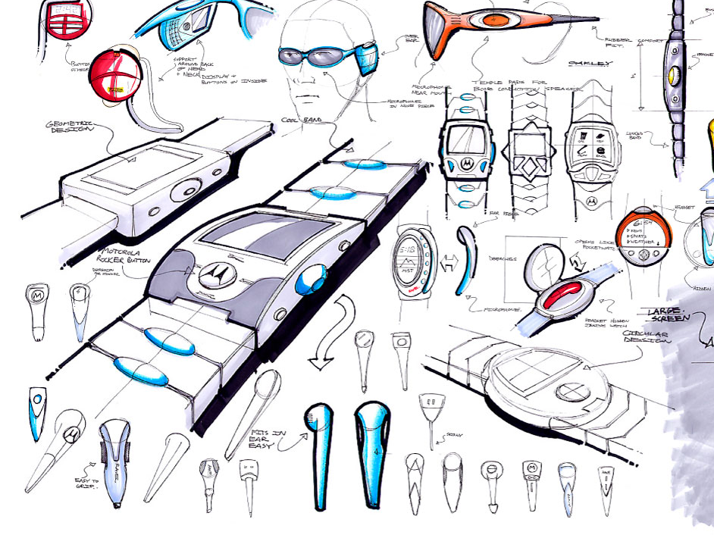
Design development
Your development must include more detailed information such as:
Sizes
Costs
Materials
Suitability for manufacturing (can it be made easily?)
You must test these ideas through:
Sketches (2D and 3D)
Models (card, foam, cardboard etc).

Slide 5
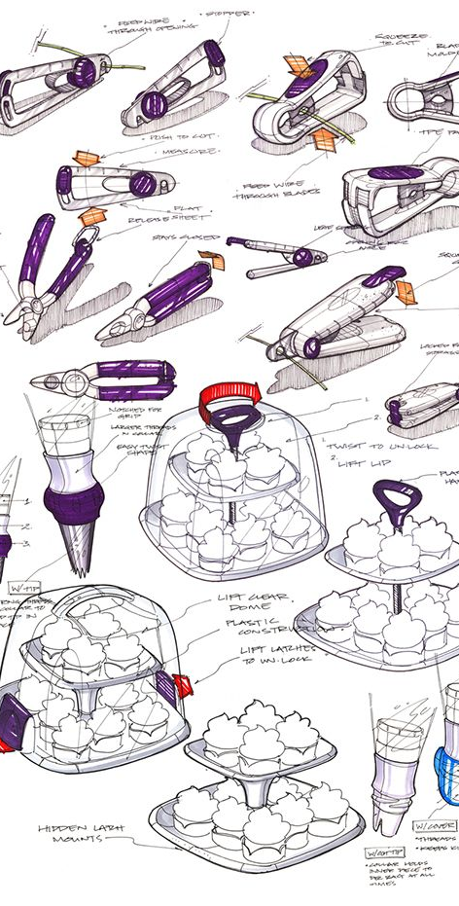
Design development
Exploring and refining should NOT be viewed as a linear process.
It is likely that, in refining an idea, further problems or areas for improvement will arise.
For example:
Changes to improve function will likely raise issues with aesthetics, materials and manufacturing.
These new issues will require exploring, testing, evaluating and refining.

Slide 6
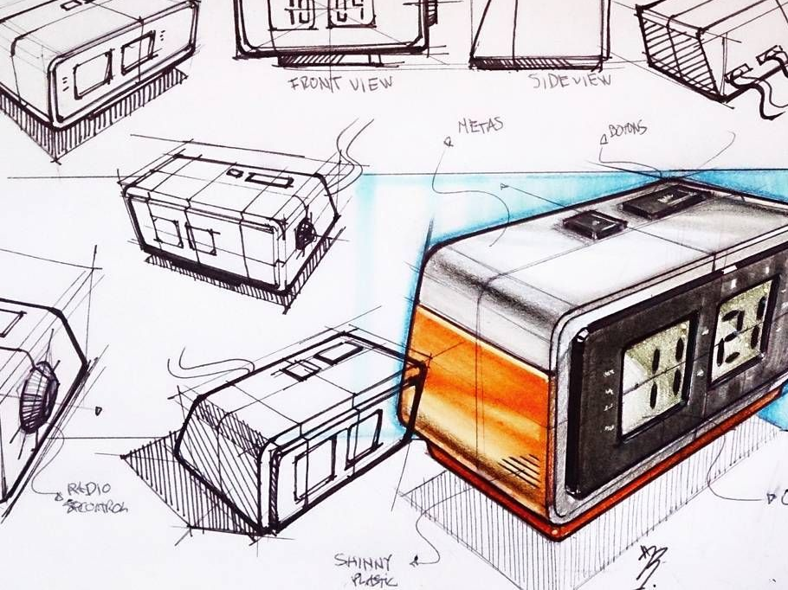
Skills builder task
An initial idea for an alarm clock is shown below. Take a few minutes to list as many possible areas for development that would make it more suitable for the teenage market.
Answers may include:
Dock for music player
Touchscreen technology
Link to other devices
Different colour combinations
A theme that appeals to teenagers
Less symmetrical form, change the position of the buttons to make them easer to access and press.

Slide 7
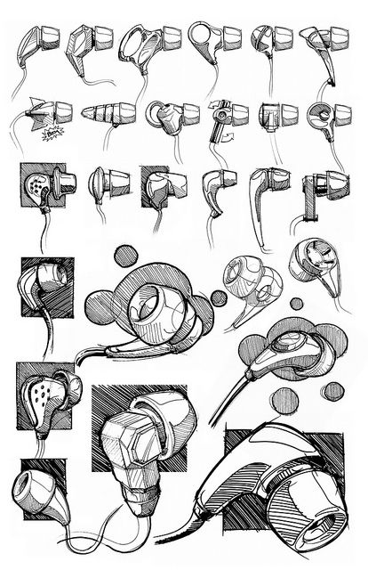
Exploring ideas
To develop your initial ideas, you can use any of the Idea Generation Techniques mentioned in the booklet given to you.
You can also take each Design Factor in turn and focus on a particular aspect of the design, develop it and then combine it again.
Look at aspects of:
Function – can this be altered, adapted, added to?
Aesthetics – can you change colour, shape, texture, form, theme
Ergonomics – can you make it easier to understand, hold, use easily?
Performance – can it be easily cleaned, maintained, is it fit for purpose?
Market – can you change the target market slightly? How would this affect aesthetics?
Some design factors may affect others as you change them!

Slide 8
Exploring ideas
Exploring requires the effective application of divergent thinking and problem solving.
Focus, at this point, is on generating, testing and evaluating different solutions that address any issues with the initial idea.
Idea generation techniques such as SCAMPER can help.

Slide 9
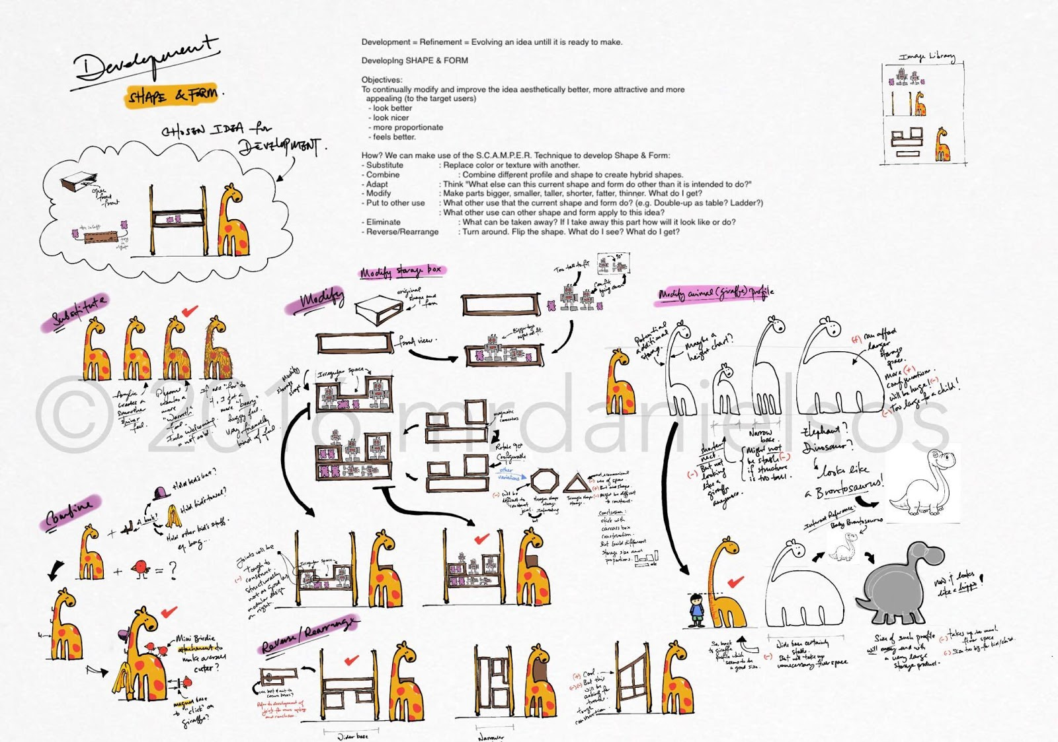

Slide 10
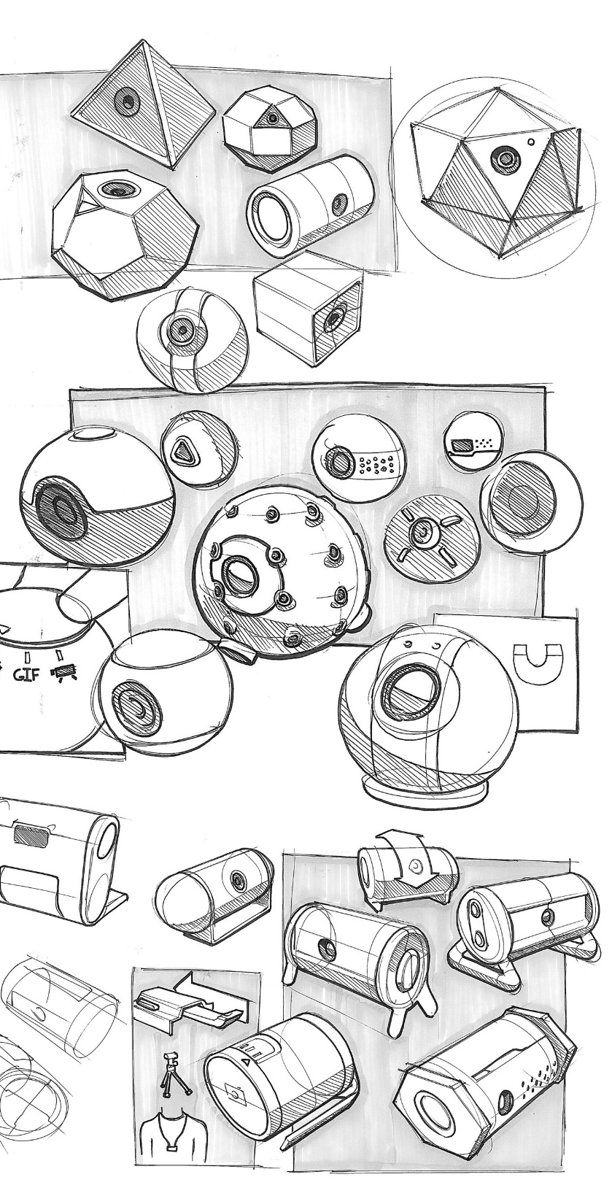
Design development
You must start to develop your chosen initial idea toward a final idea.
This is the idea that you will manufacture in the workshop.
You must create at least 2 A3 pages of design development for your phone holder.
On a new A3 sheet, add the title “Design Development 1” and begin to develop your initial idea using:
Design Factors
Idea Generation Techniques
SCAMPER

